Slide 1



PROGRESS REPORT / UPDATES
By: Nick Fauber, Kayla Granger, Alec Howard, Saph Mabalot

Slide 2
Introduction | Synthea Usage
This progress reports gives an update on DataBridge
Already finished the SRS and the Use-Case and UML diagrams
Started a change log and a security policy on GitHub
Added hardware security keys for MFA
Updated budget is already finalized
Synthea and Our Database
We run synthea to generate a set of fake patients and export them as CSV files
A python import script reads the patient file and inserts each synthetic patient into our patient table (Synthea ID)
Same script reads the vital records.
Nurse submits a chart entry -> Saved to the documentation table -> converted to HL7v2 message and then sent to EHR receiver -> Message is stored and recorded in audit logs.

Slide 3
Project Timeline | Gantt Overview
Planned schedule from the original proposal • Aug 18 – Dec 15, 2026
AUG
SEP
OCT
NOV
DEC
Proposal & scope
Requirements gathering / SRS
Finalize SRS & technical scope
Architecture, DB, UI plan, auth/RBAC
Bedside UI, API, DB, HL7v2 proof of concept
HLD & simulated EHR receiver
Integration, testing, security & audit logs
Final testing, docs, demo & report

Slide 4
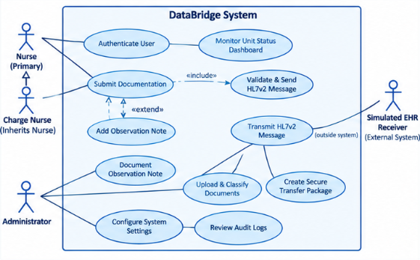
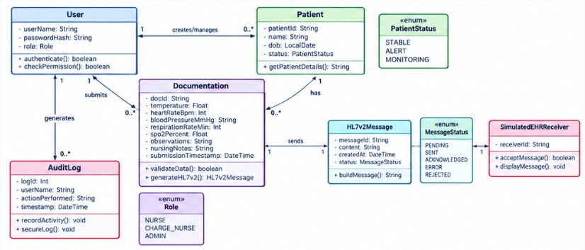
Diagram Comparison | Concept To Design
USE-CASE DIAGRAM
UML CLASS DIAGRAM
Actors + user goals
Classes + relationships

Slide 5
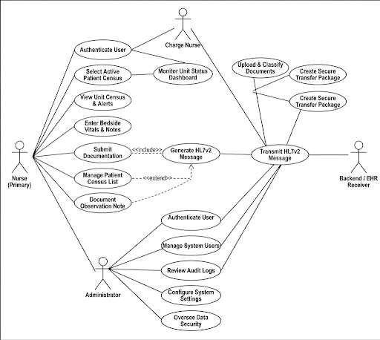
Use-Case (Before)

Slide 6
Use-Case (After)

Slide 7
Updates
Added a system boundary labeled DataBridge System.
Changed the external actor from Backend / EHR Receiver to Simulated EHR Receiver (External System).
Established an inheritance relationship between Nurse (Primary) and Charge Nurse.
Changed Generate HL7v2 Message to Validate & Send HL7v2 Message.
Clarified that transmitting HL7v2 messages occurs outside the system.
Changed Document Observation Note to Add Observation Note and linked it to Submit Documentation using an <<extend>> relationship.
Retained the document upload, classification, and secure transfer package use cases.
Retained the administrator functions for configuring system settings and reviewing audit logs.
Removed or no longer displayed several original use cases, including selecting active patients, viewing census and alerts, entering bedside vitals, managing the patient census list, and overseeing data security.

Slide 8
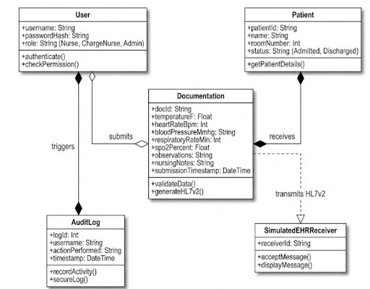
UML Diagram (Before)

Slide 9
UML Diagram (After)

Slide 10
Updates
Added an active: Boolean attribute to the User class.
Introduced a Role enumeration containing NURSE, CHARGE_NURSE, and ADMIN.
Changed the Patient class from roomNumber to bed: Location.
Replaced the patient's general string status with a PatientStatus enumeration containing STABLE, ALERT, and MONITORING.
Added spo2Percent: Float and submissionTimestamp: DateTime to the Documentation class.
Introduced a dedicated HL7v2Message class to manage message content, creation time, and transmission status.
Added a MessageStatus enumeration with PENDING, SENT, ACKNOWLEDGED, ERROR, and REJECTED.
Added recordActivity() and secureLog() operations to the AuditLog class.
Clarified relationships and multiplicities between users, patients, documentation, and HL7v2 messages.
Improved the representation of audit logging and message transmission to the simulated EHR receiver.

Slide 11
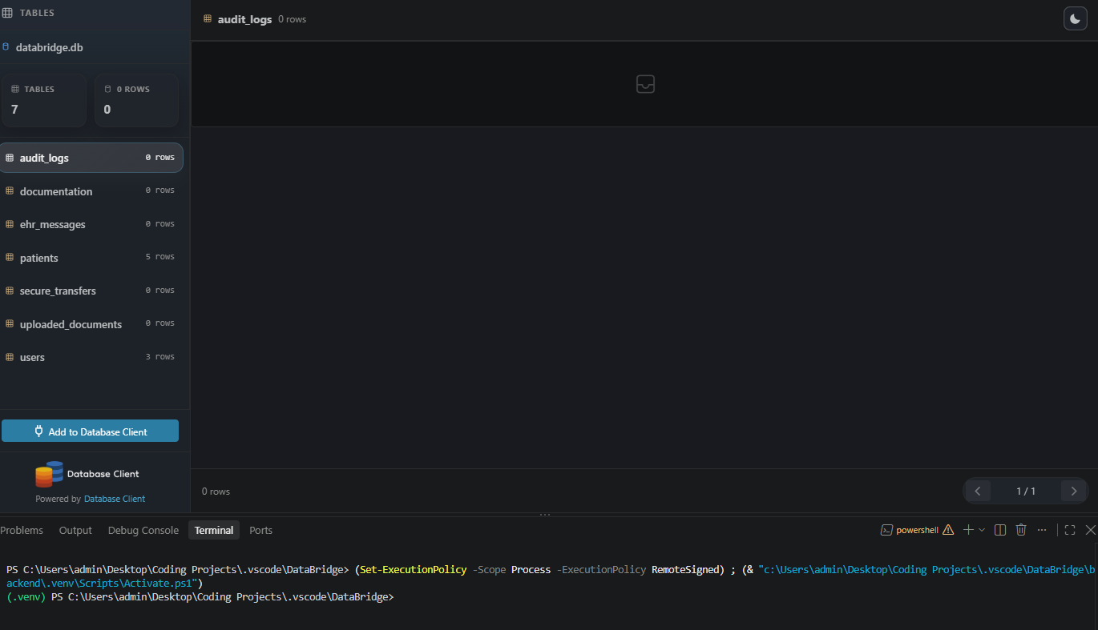
SQLite - Database Management w/.venv

Slide 12
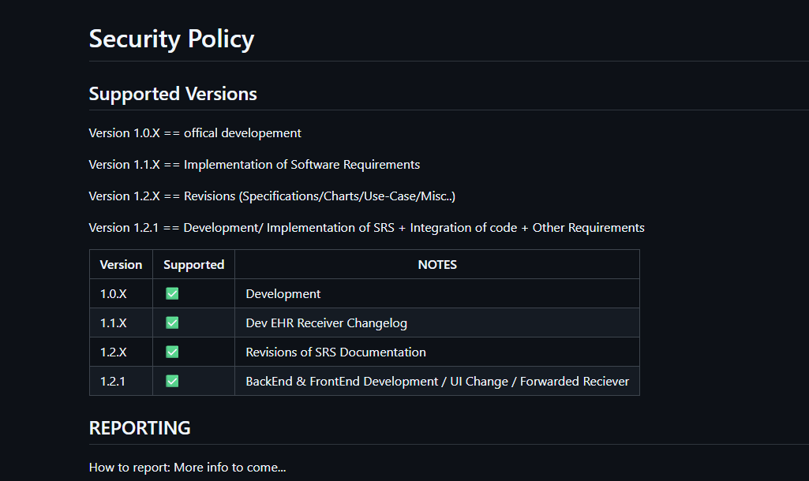
ChangeLog - GITHUB (Security.md)
A changelog records updates and changes made to a project.
It explains what was added, fixed, or removed.
It helps users track changes made to the system over time.

Slide 13


Slide 14
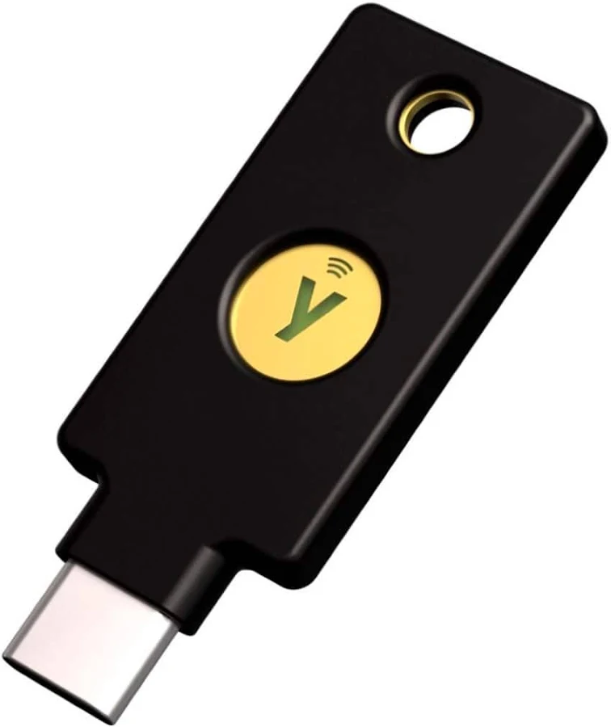
Security Key | MFA Support
Physical security keys used to support multi factor authentication (MFA) and help prevent unauthorized account access. Only Given to CHARGE NURSES OR ADMIN FOR BIGGER DATA COMPLEXITY.

Slide 15
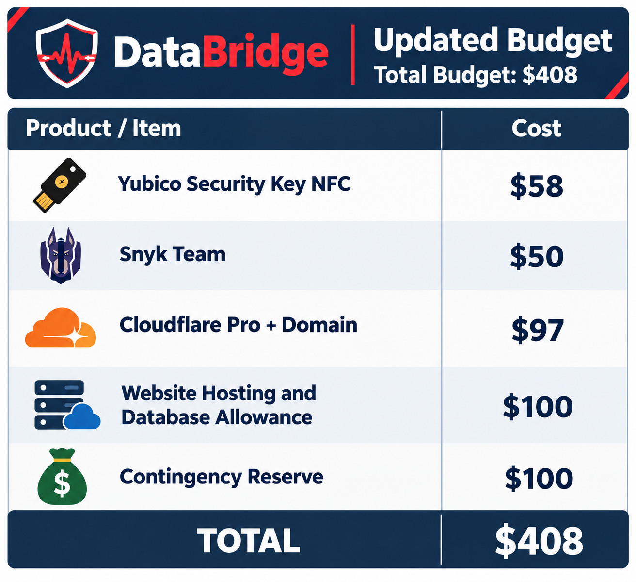
Budget

Slide 16
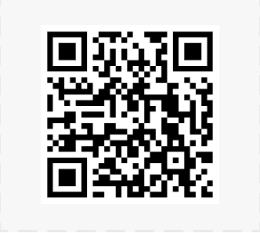
Git-Repo

Slide 17
References
[1] Yubico, “Security Key NFC by Yubico,” Yubico. [Online]. Available: https://www.yubico.com/product/security-key-series/security-key-nfc-by-yubico-black/. [Accessed: Oct. 19, 2026].
[2] National Institute of Standards and Technology, “Digital Identity Guidelines: Authentication and Authenticator Management,” NIST Special Publication 800-63B-4. [Online]. Available: https://pages.nist.gov/800-63-4/sp800-63b.html. [Accessed: Oct. 14, 2026].
[3] Snyk, “Snyk,” Snyk. [Online]. Available: https://snyk.io/. [Accessed: Oct. 16, 2026].
[4] Cloudflare, “Plans and Pricing,” Cloudflare. [Online]. Available: https://www.cloudflare.com/plans/. [Accessed: Oct. 16, 2026].
[5] Cloudflare, “What Is Cloudflare Registrar?,” Cloudflare Developers. [Online]. Available: https://developers.cloudflare.com/registrar/about/. [Accessed: Oct. 16, 2026].
[6] Amazon Web Services, “Amazon RDS for PostgreSQL Pricing,” AWS. [Online]. Available: https://aws.amazon.com/rds/postgresql/pricing/. [Accessed: Oct. 16, 2026].
[7] Amazon Web Services, “Generating Amazon EC2 Estimates,” AWS Pricing Calculator User Guide. [Online]. Available: https://docs.aws.amazon.com/pricing-calculator/latest/userguide/ec2-estimates.html. [Accessed: Oct. 19, 2026].
[8] OWASP Foundation, “Database Security Cheat Sheet,” OWASP Cheat Sheet Series. [Online]. Available: https://cheatsheetseries.owasp.org/cheatsheets/Database_Security_Cheat_Sheet.html. [Accessed: Oct. 19, 2026].

